Slide 1


Research Proposal CY-801
Synergic Effect of Doping and Outcoupling Enhancement for High-Efficiency Perovskite Light Emitting Diodes.
By
Ranadeep Raj S
Supervisor
Dr. Murali Banavoth
School of Chemistry
University of Hyderabad

Slide 2
Outline
Introduction
Essentials for efficient LEDs
Why perovskites?
Non-radiative recombination loss
Extraction of emitted photons
Summary
1
2
3
4
5
6

Slide 3
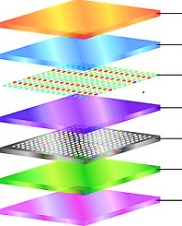
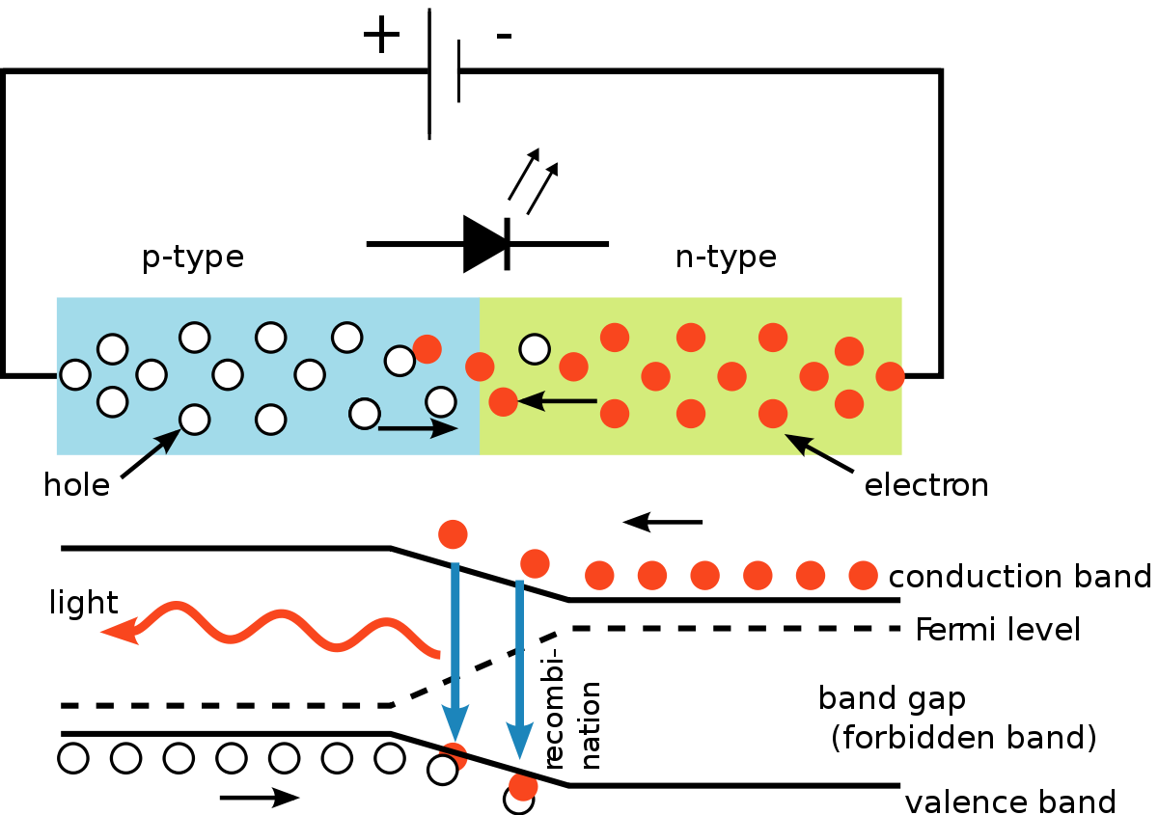
Introduction
LEDs convert electricity directly into photons of light, instead of the wasteful mixture of heat and light.
Advantages of using LEDs
LEDs produce more light per watt.
LEDs can emit light of an intended color without the use of color filters.
LEDs can have a relatively long life.
Cathode
ETL
Emission layer
HTL
HIL
Anode
Substrate

Slide 4
Essentials for efficient LEDs
Direct band gap semiconductor
Optical confinement
Carrier confinement
Higher photoluminescence quantum efficiency
Higher external quantum efficiency
Brighter and efficient LEDs

Slide 5
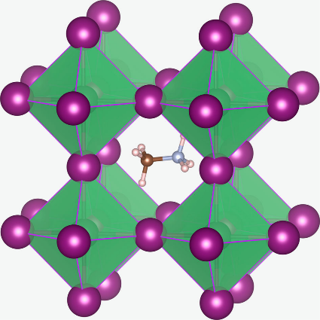
Why perovskites?
Perovskites promise a bright future for light-emitting diodes (LEDs) owing to their desirable optoelectronic properties
Photoluminescence QY
Tunable band gaps
High color purity
Suppressed defect formation
Low non-radiative recombination
This Photo by Unknown Author is licensed under CC BY-SA

Slide 6
Strategy to overcome the snags
Numerous approaches have been proposed to improve the device performance of PeLEDs primarily by controlling
Film morphology
Chemical compositions of perovskite materials
Tuning the interfacial energy levels at the contacts.
This proposal is focused on
Non-radiative recombination loss
Extraction of emitted photons.
02
doping
Fabrication
01
02
PLQY
Outcoupling(EQE)
01
Efficient PeLEDs

Slide 7
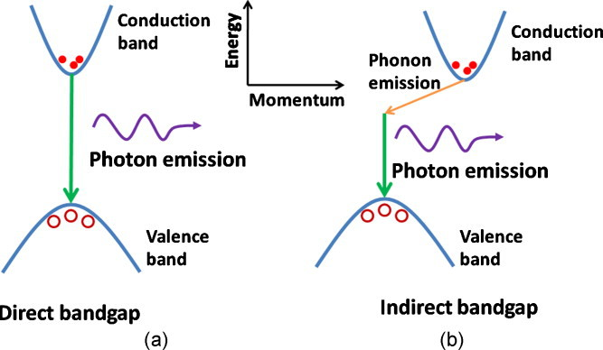
Non-radiative recombination loss
The defects, probably vacancies can deteriorate the short-range order of the lattice and act as trapping centers of photogenerated carriers.
These defects form localized defects states which trap charge carriers and leads to the formation of indirect band gaps.
Advances in Optics and Photonics, Vol. 3, pp. 53-87 (2011).

Slide 8
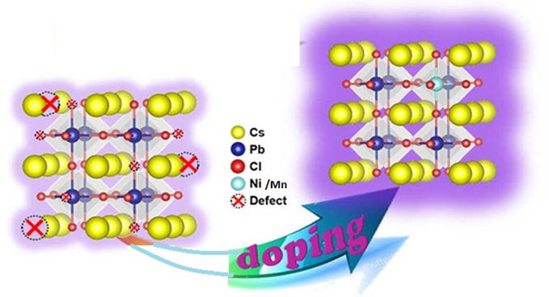
Doping of perovskites
Low PLQY in undoped NCs is associated with short-range disorder of the lattice.
Designed a general strategy for the synthesis of light emitting CsPbX₃ NCs (X = Cl, Br, I) to obtain high PLQY through Manganese (Mn) doping.
Mn doping may eliminate these defects and result in increased short-range order of the lattice.
May increase defect formation energy.
Journal of the American Chemical Society, 140(31), 9942-9951.

Slide 9

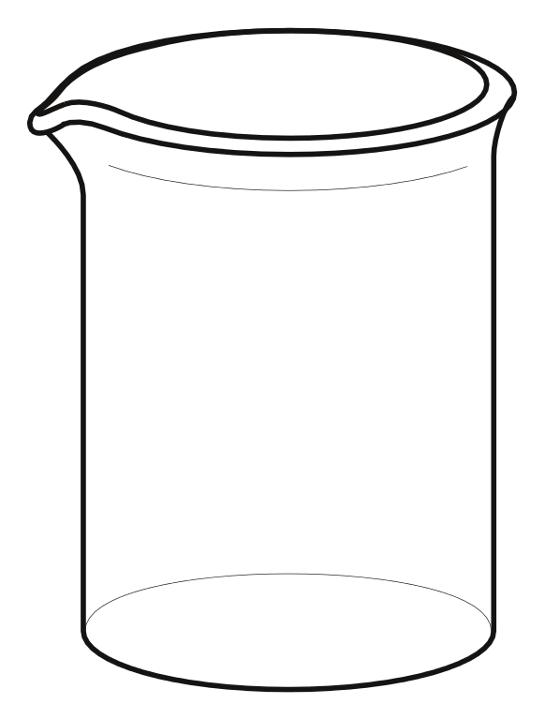
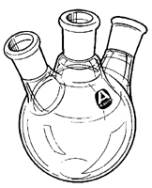
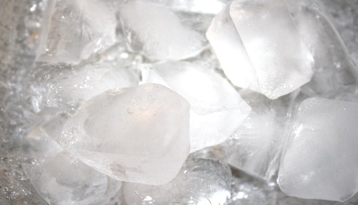
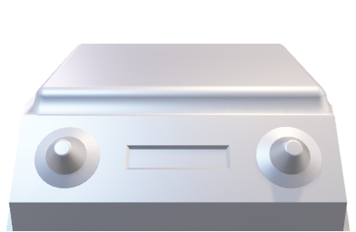
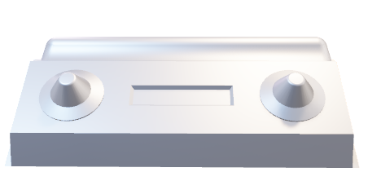
Synthesis of Mn-Doped CsPbX₃
Outline and Fields of Interest
PbX₂+dried MnX₂ +ODE+ OAm+OA+
TOP
X= I, Cl, Br
Oleylamine (OAm),
1-Octadecene (ODE),
Tri-n-octylphosphine (TOP)
Cs-oleate solution
60 seconds
Dry under vacuum for 1 hr at 120 °C, and then heat under N₂ at 120 °C
Keep for 5 min at 210 °C temperature and add Cs-oleate
Cool the reaction mixture in ice–water bath

Slide 10
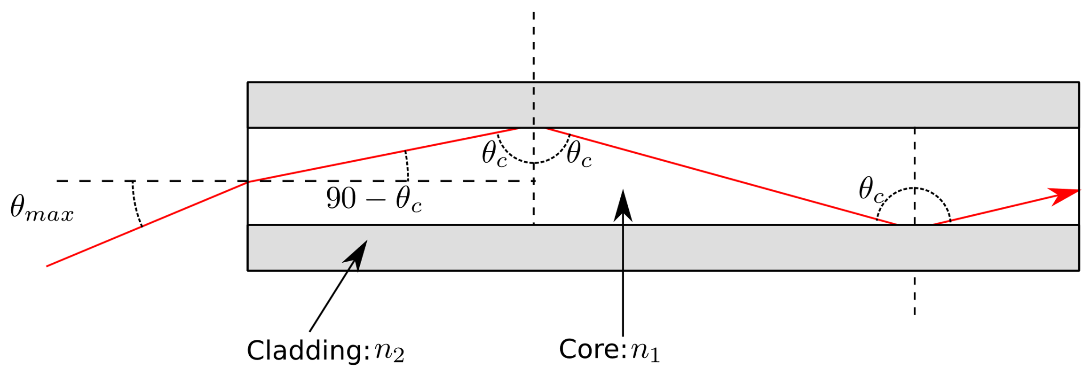
Extraction of emitted photons
Outline and Fields of Interest
EQE in conventional PeLEDs have low light outcoupling efficiency.
Caused by a large refractive index difference between the active layer and charge injection layers.
The refractive indexes at 550 nm wavelength
Perovskite(CsPbCl₃) n_{pero} ≈ 2.25
(3,4-ethylenedioxythiophene) polystyrene sulfonate n_{PEDOT:PSS} ≈ 1.5
(F8) Poly(9,9-di-n-octylfluorenyl-2,7-diyl) n_{F8} ≈ 1.7
For high EQE there is need of enhancing outcoupling efficiency.
Injection layers(ETH)
Active layer(perovskite)
injection layers(HTL)

Slide 11
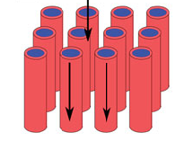
Enhancing outcoupling efficiency
Outline and Fields of Interest
Widely adopted material system is
ITO/PEDOT: PSS /Perovskite / Poly(9,9-di-n-octylfluorenyl-2,7-diyl) (F8)/Ag
Reduce surface reﬂection and improve device power conversion
efﬁciency.
The nanostructures can improve refractive index matching
Anodic alumina membranes (AAMs) Nanophotonic substrate
ITO/AAMs/PEDOT: PSS /Perovskite / Poly(9,9-di-n-octylfluorenyl-2,7-diyl) (F8)/Ag
AAM
Nanophotonic structures
Schematic-illustration-of-nanophotonic-structures-used-for-light-trapping-a-1D-Bragg_fig2_231899465

Slide 12
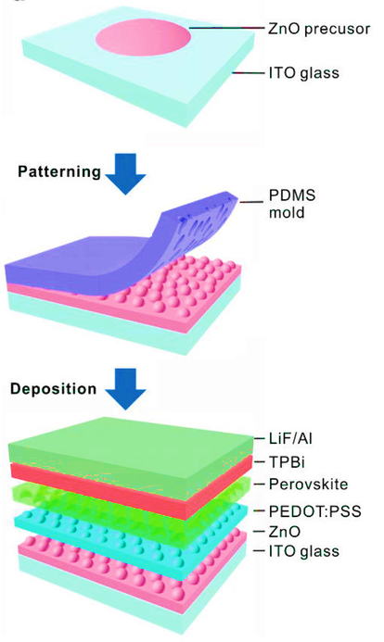
Outline and Fields of Interest
MEN
Moth‐eye nanostructures
Bioinspired moth‐eye nanostructures (MEN)
Suppress reflections at interfaces
Cost‐effective method for outcoupling the waveguided light
. Advanced Materials, 1901517,(2019).

Slide 13
Cost of the project
Outline and Fields of Interest
S.No | Title | Cost in Lakh | Required time
1 | Synergic effect of Doping and outcoupling enhancement for high-efficiency perovskite light emitting diodes. | The total cost of the project is 25,00,000 INR | 2 Years
2 | Thermal Evaporator | 5,00,000
3 | Glove box | 15,00,000
4 | Spin Coater | 1,00,000
5 | Chemicals | 3,00,000
6 | Other required instruments | 1,00,000

Slide 14
Time schedule
Outline and Fields of Interest
Description of task | 1-6 months | 6-12 months | 12-18 months | 18-24 months
Synthesis of the perovskite
Characterization
Fabrication
Property characterization and measurements

Slide 15
Summary
Outline and Fields of Interest
High‐performance CsPbX₃ PeLEDs have to be achieved by implementing simple and cost‐effective methods
Doping may increase PLQY to obtain high-efficiency PeLED which is stable and brighter.
Nanophotonic structures may increase EQE through outcoupling enhancement

Slide 16
Acknowledgement
Outline and Fields of Interest
Dr. Murali Banavoth ( Research supervisor)
Prof. Pradeepta K. Panda, Prof. Srinivasarao Yaragorla (DRC Members)
Present and former Deans, School of Chemistry
All the faculty members, School of Chemistry
Lab mates, friends, parents
CSIR, DST, UGC.

Slide 17
Outline and Fields of Interest
Thank you

